Slide 1
Basic City Building Game in C++
by
Dirsehan Başaran Müfit Kutay Ökten
Gökmen Veyisoğlu Yusuf Ziya Kural

Slide 2

Features of The Game
Basic City Building and Resource Control Game
The Game
Units
and
Resources
Buildings
The Map

Slide 3
Income from
Lumberjacks and Mines
Money
Units
and
Resources
Happiness
School and Hospital Closeness
(5x5 area that is close to Houses)
Tour
Limitor Factor (Limitless)
Action
Limitor Factor (5 actions per tour)
The Map
X axis coordinate
Y axis coordinate
Mine
Gathers Money per Action
Buildings
Lumberjack
House
Hospital
Gathers Happiness at the Near of the Houses (5x5 area)
School

Slide 4
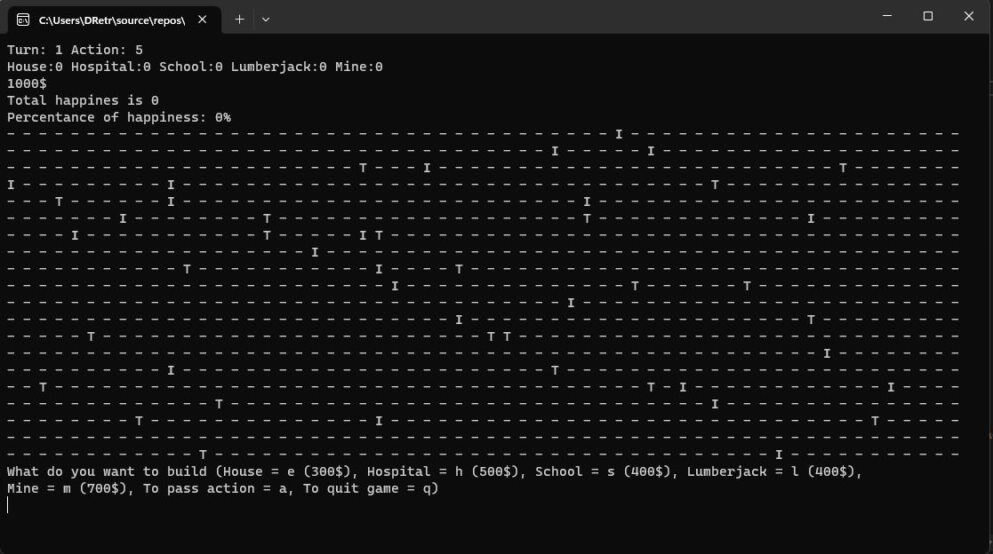

Slide 5
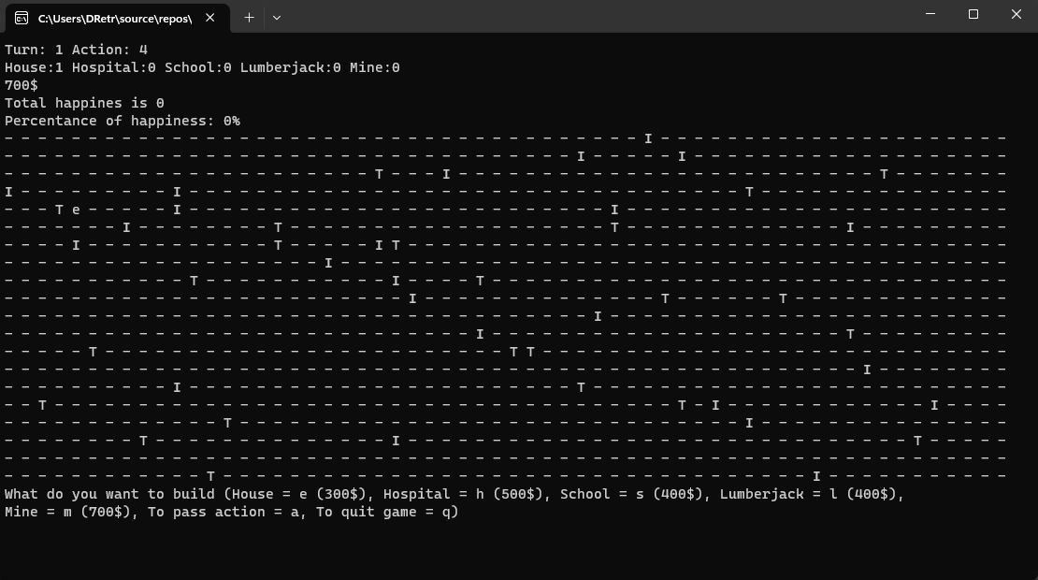

Slide 6
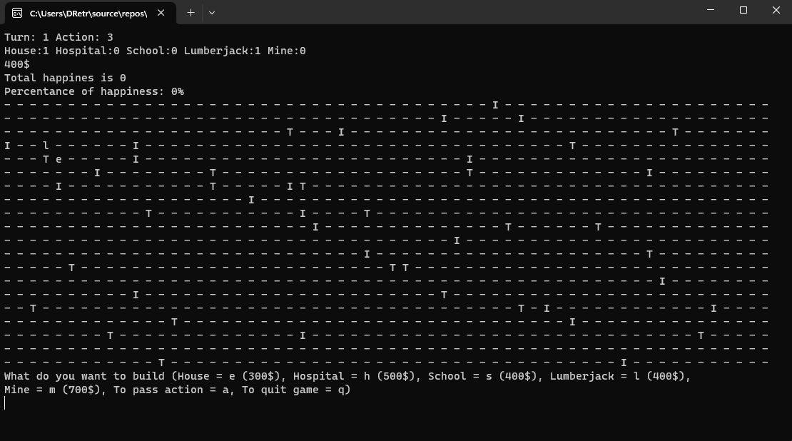

Slide 7
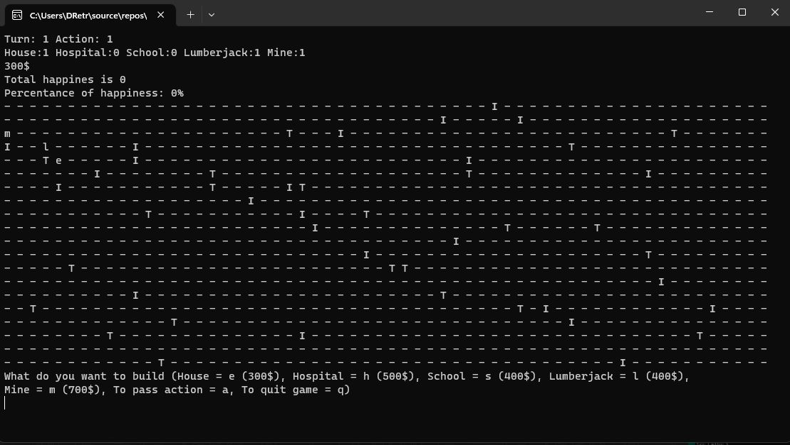

Slide 8
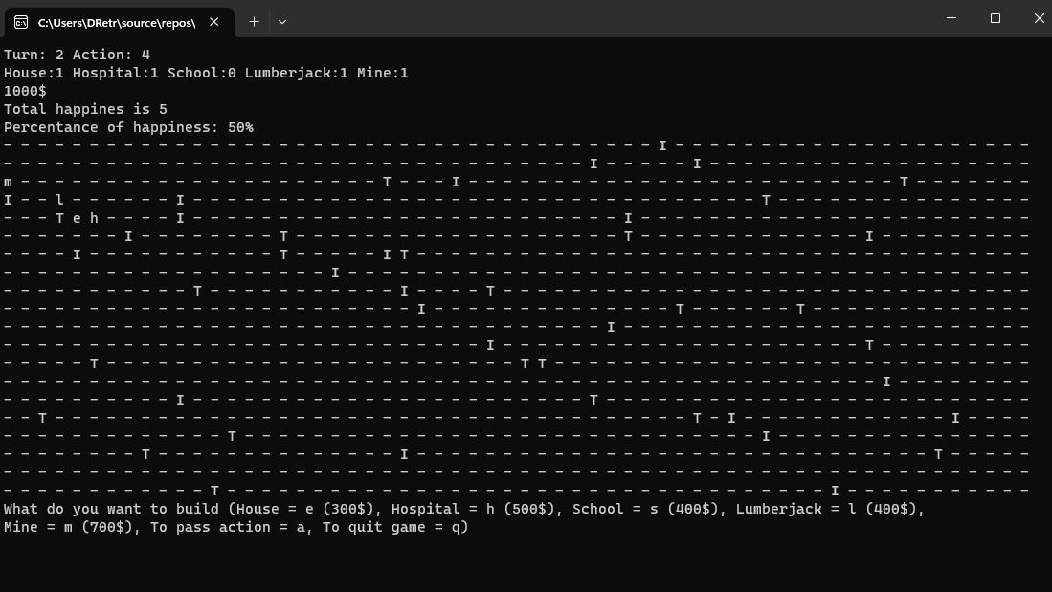

Slide 9
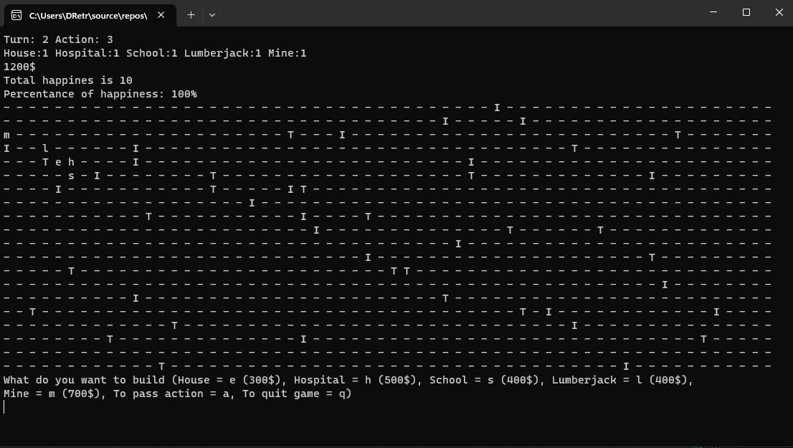

Slide 10
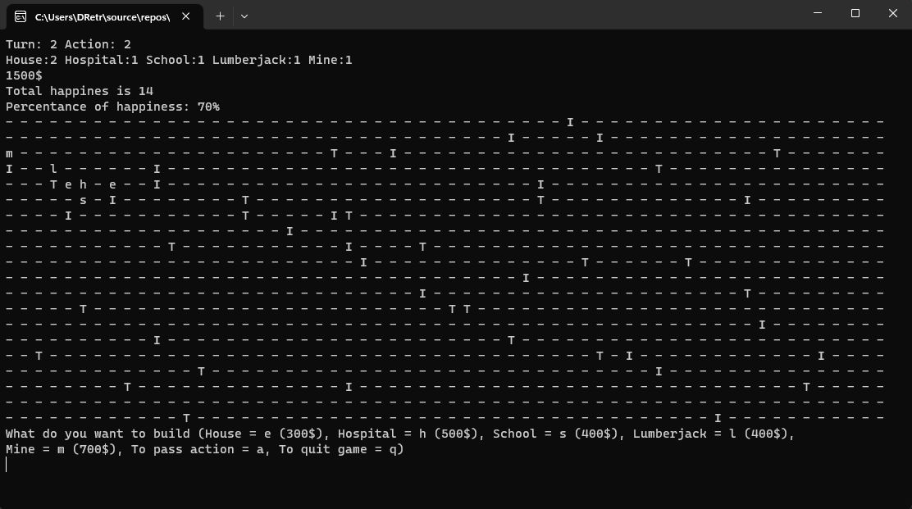

Slide 11
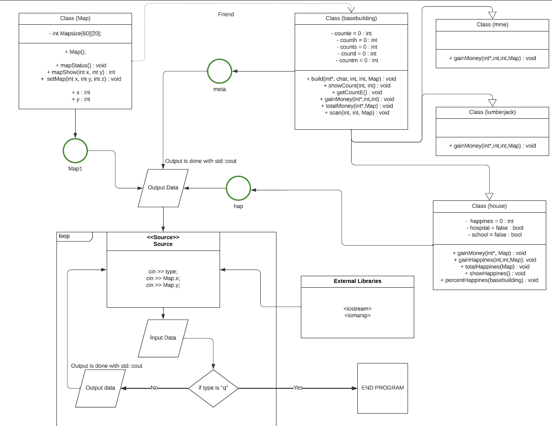

Slide 12
By Getting All Together:

